Slide 1
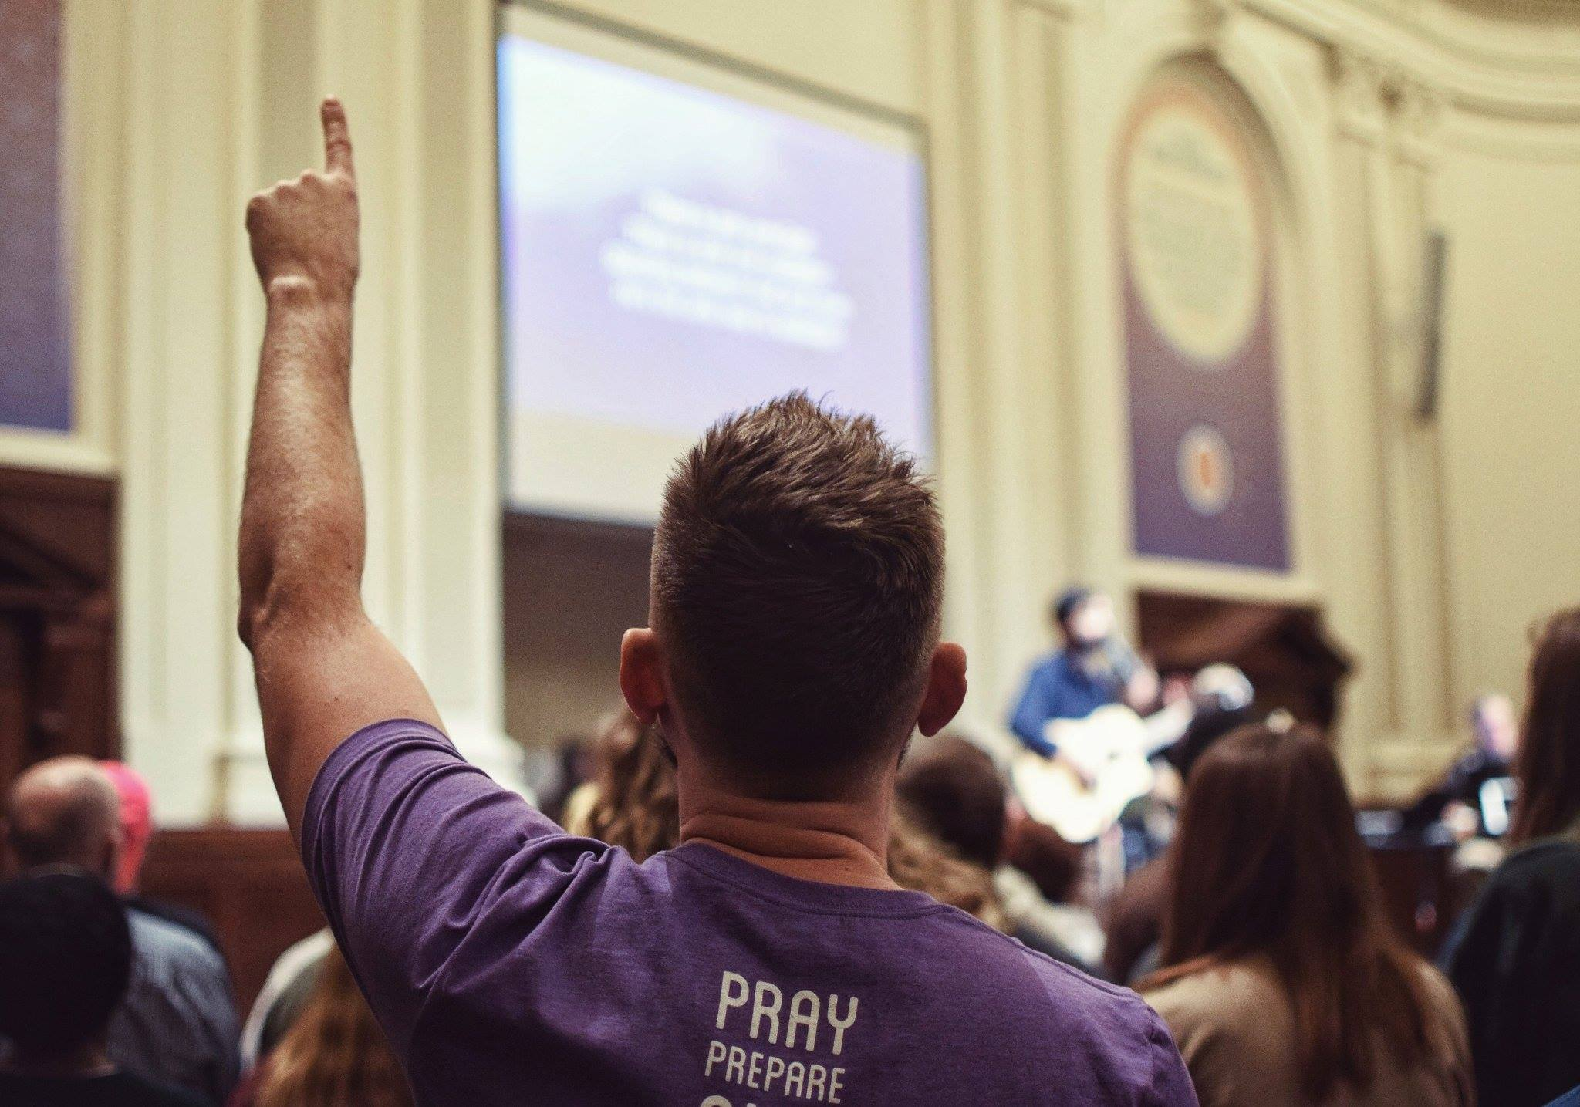
0
Vision
REPORT
2
7
1

Slide 3
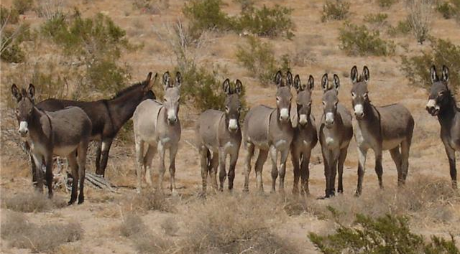

The People’s King #3 – 1 Samuel 10

Slide 4
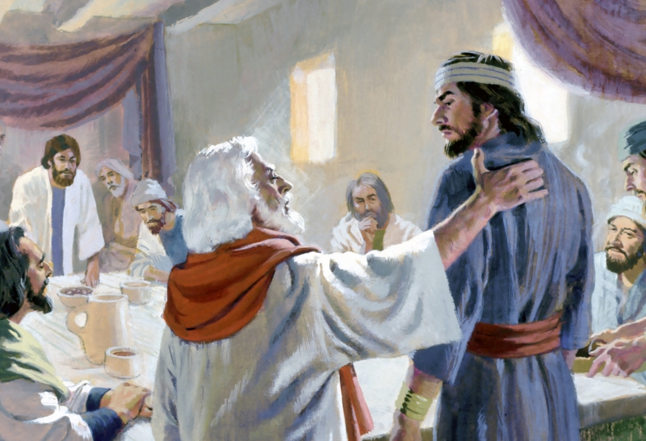

Slide 5
Rev 1:4-6 John to the seven churches which are in Asia: Grace be unto you, and peace, from him which is, and which was, and which is to come; and from the seven Spirits which are before his throne; 5And from Jesus Christ, who is the faithful witness, and the first begotten of the dead, and the prince of the kings of the earth. Unto him that loved us, and washed us from our sins in his own blood, 6 And hath made us kings and priests unto God and his Father; to him be glory and dominion for ever and ever. Amen.

Slide 6
1 Peter 3:15 But sanctify the Lord God in your hearts: and be ready always to give an answer to every man that asketh you a reason of the hope that is in you with meekness and fear:
Matthew 10:32 Whosoever therefore shall confess me before men, him will I confess also before my Father which is in heaven.

Slide 7
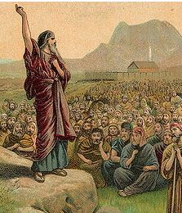
A calling to God.
Good ministers call people together unto the LORD.
Mizeph = “watchtower”
KEY: When need direction, go back to the place of revival, blessing and victory!

Slide 8
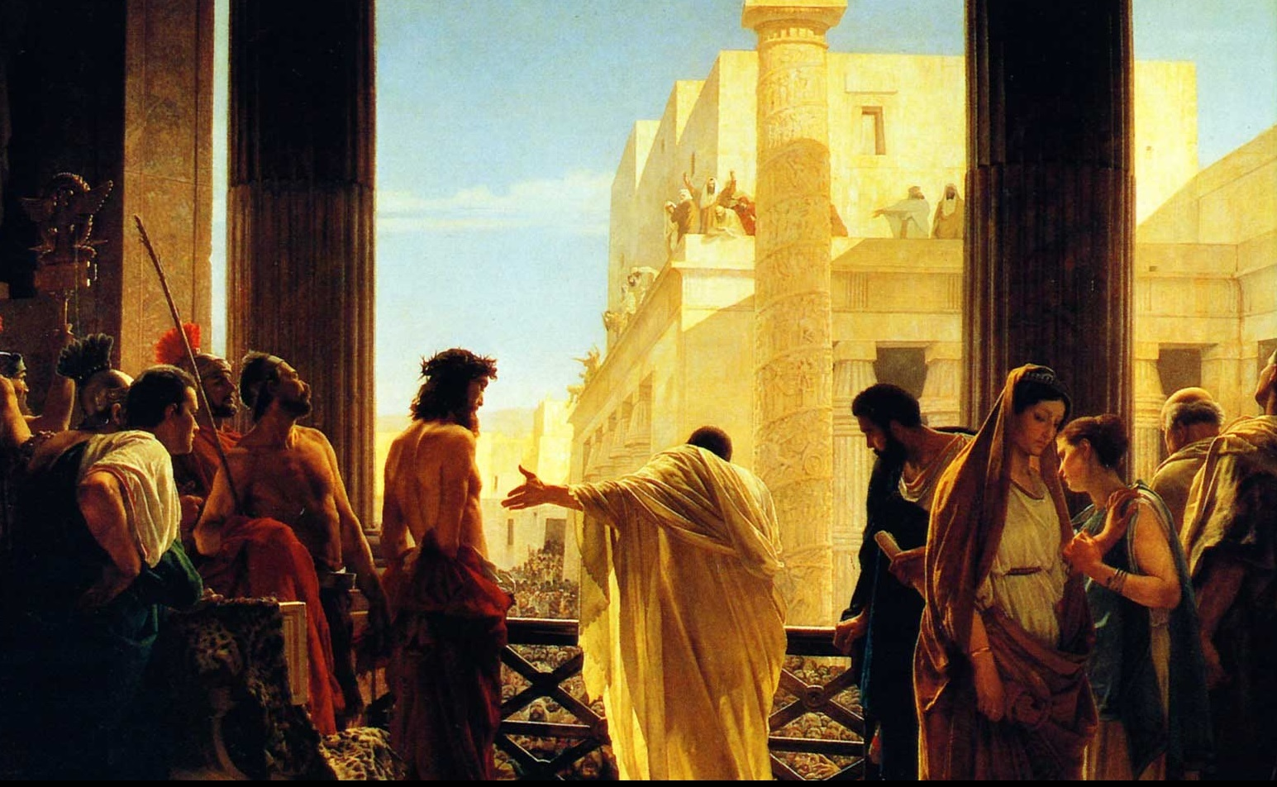
A warning about replacing God with a king.
We forget that God is WHO / WHAT we need. The security that comes from man always comes up short.
Israel rejected God’s rule over her. Us?

Slide 9
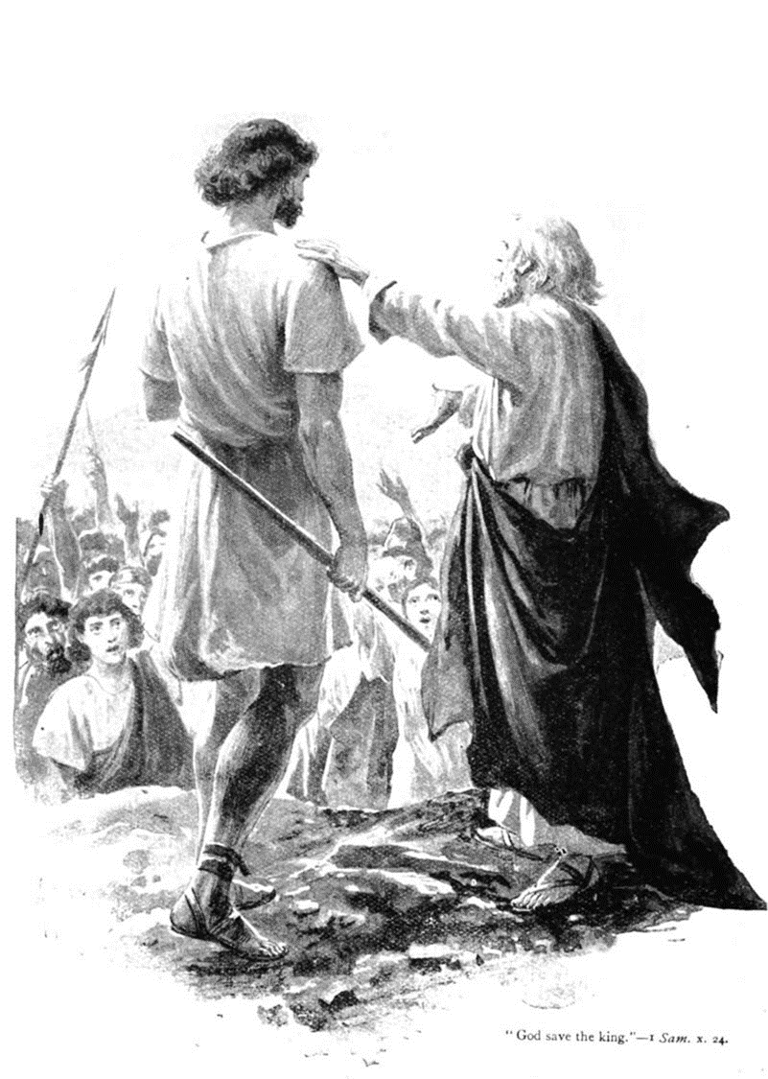
A lot to show Israel that Saul was God’s answer to Israel’s request; not Samuel’s!
The lot was used by Israel to discern the Lord’s will.
Proverbs 16:33 The lot is cast into the lap; But the whole disposing thereof is of the Lord.
Today, does the church use the lot? No.
We have the completed Word of God.

Slide 10
Philippians 1:9-11 And this I pray, that your love may abound yet more and more in knowledge and in all judgment; 10 That ye may approve things that are excellent; that ye may be sincere and without offence till the day of Christ; 11 Being filled with the fruits of righteousness, which are by Jesus Christ, unto the glory and praise of God.

Slide 11
Danger! Beware divination – the growing lie today is that divination
is actually ok with God.

Slide 12
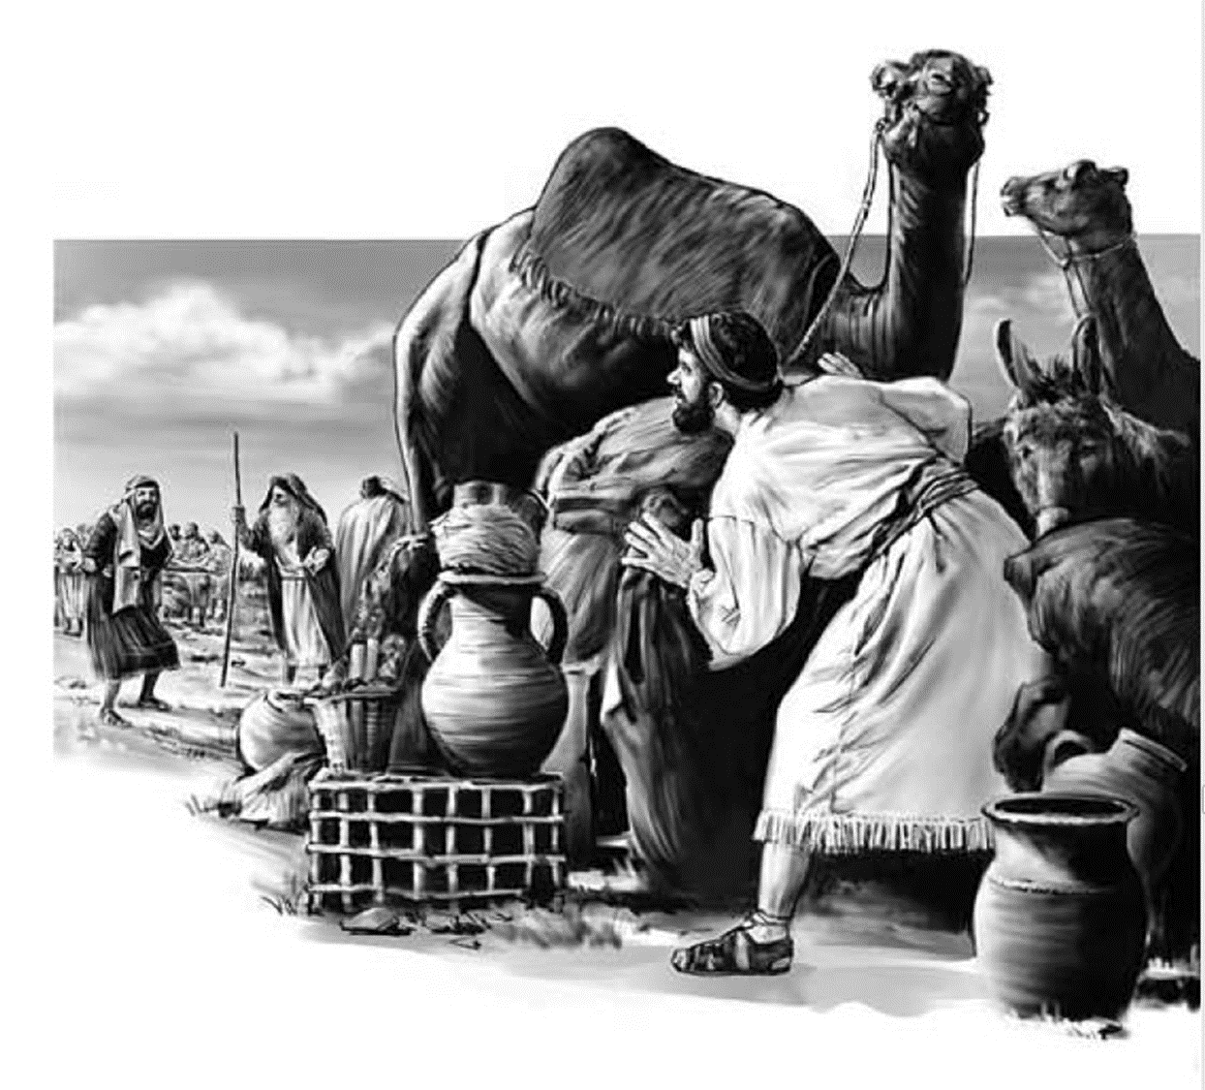
A reluctant leader.
When God gives you the opportunity will you move forward?
Saul desired the office of
king. (1 Tim 3:1) Saul
wanted the job!
He wanted the position,
the prestige, the power.
But when it was time to take the responsibility Saul was nowhere to be found!

Slide 13
2 Corinthians 11:23-28 Are they ministers of Christ? (I speak as a fool) I am more; in labours more abundant, in stripes above measure, in prisons more frequent, in deaths oft. 24 Of the Jews five times received I forty stripes save one. 25 Thrice was I beaten with rods, once was I stoned, thrice I suffered shipwreck, a night and a day I have been in the deep; 26 In journeyings often, in perils of waters, in perils of robbers, in perils by mine own countrymen, in perils by the heathen, in perils in the city, in perils in the wilderness, in perils in the sea, in perils among false brethren; 27 In weariness and painfulness, in watchings often, in hunger and thirst, in fastings often, in cold and nakedness. 28 Beside those things that are without, that which cometh upon me daily, the care of all the churches.

Slide 14
1 Peter 5:2-4 Feed the flock of God which is among you, taking the oversight thereof, not by constraint, but willingly; not for filthy lucre, but of a ready mind; 3 Neither as being lords over God's heritage, but being ensamples to the flock. 4 And when the chief Shepherd shall appear, ye shall receive a crown of glory that fadeth not away.

Slide 15
Humility does not hide from God’s will.
“If God called a man to a kingship, he has no right to hide away.”
G. Campbell Morgan
Proverbs 15:3 The eyes
of the LORD are in every
place, beholding the evil
and the good.

Slide 16
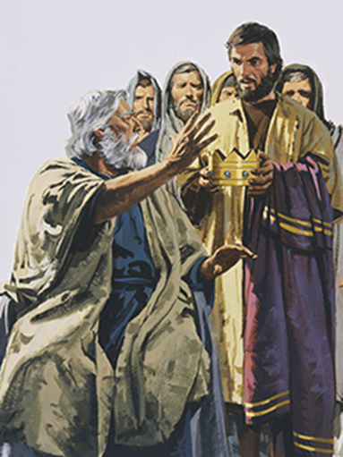
Saul: An impressive man in the eyes of man.
Saul looked good.
Samuel tries to encourage the people, by pointing out that Saul was a stud.
Samuel tries to warn the people by bringing them back to the Word of God.
Homework – to see the issues Samuel was warning and recording study out
Deut 17:14-20.

Slide 17
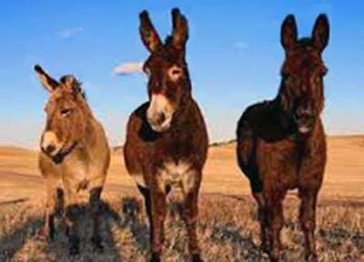
Saul could have demanded submission to his reign.
Instead, he played it cool.
The best revenge against your detractors? A life of God blessed ministry.
Don’t forget: later, Saul ends up messed up!

Slide 18
The People’s King #3 – 1 Samuel 10

